Slide 1
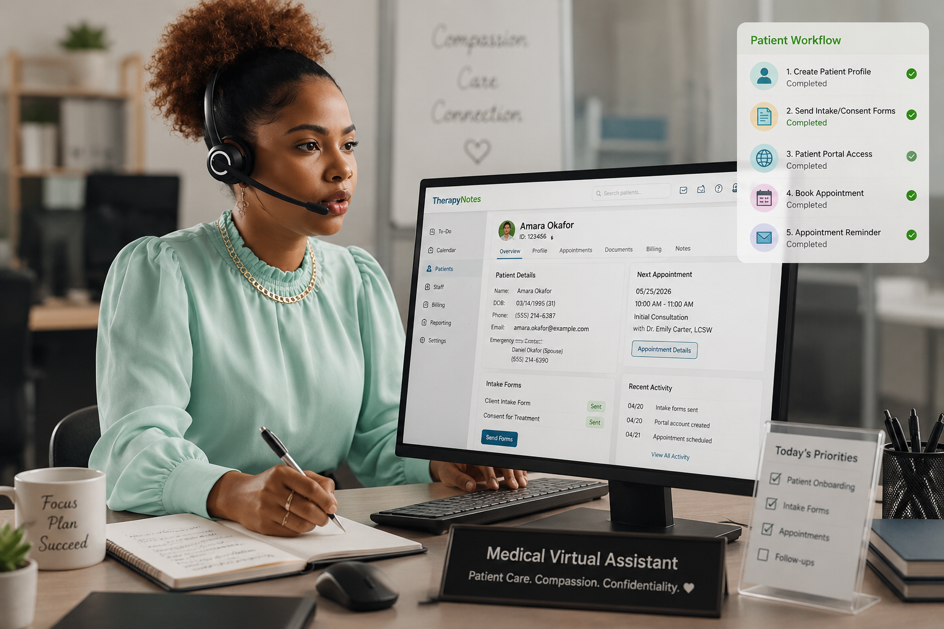
Patient Onboarding &
Scheduling Workflow
Mock Clinic: Blossom Women's Health & Wellness Clinic
EHR Platform: Therapy Notes (simulation)

Slide 2

Blossom WOMEN'S HEALTH & WELLNESS CLINIC
PATIENT ONBOARDING & SCHEDULING WORKFLOW
Mock Patient Persona
P
Age: 31
☎
Date of Birth: 14 March 1995
Phone: 09134567891
Email: amara.okafor@example.com
Patient Scenario
Amarachi is a 31-year-old pregnant (G2P1) woman at approximately 10 weeks gestation. She reaches out to our clinic through our Instagram DMs and requests for facility contact after high profile reviews from celebrities. She later calls in complaining of light pink spotting and mild lower abdominal discomfort. During her pregnancy, she also reports increased anxiety, difficulty adjusting emotionally to the pregnancy, and concerns about balancing pregnancy with work and family responsibilities.
Calling to request an
appointment
Mrs. Amarachi Okafor
Blossom Women's Health & Wellness Clinic • Patient Onboarding & Scheduling Workflow • OBS & GYN / Women's Health Care

Slide 3
Blossom WOMEN'S HEALTH & WELLNESS CLINIC
PATIENT ONBOARDING & SCHEDULING WORKFLOW
R
Workflow Roadmap
Six phases from first call to appointment-ready patient
1
2
3
Patient Calls to
Request Appointment
Patient Profile
Created
Intake Form &
Welcome Message Sent
→
→
4
5
6
Patient Portal
Experience
Availability Checked &
Appointment Scheduled
Confirmation &
Pre-Appointment Forms Sent
→
→
Blossom Women's Health & Wellness Clinic • Patient Onboarding & Scheduling Workflow • OBS & GYN / Women's Health Care

Slide 4
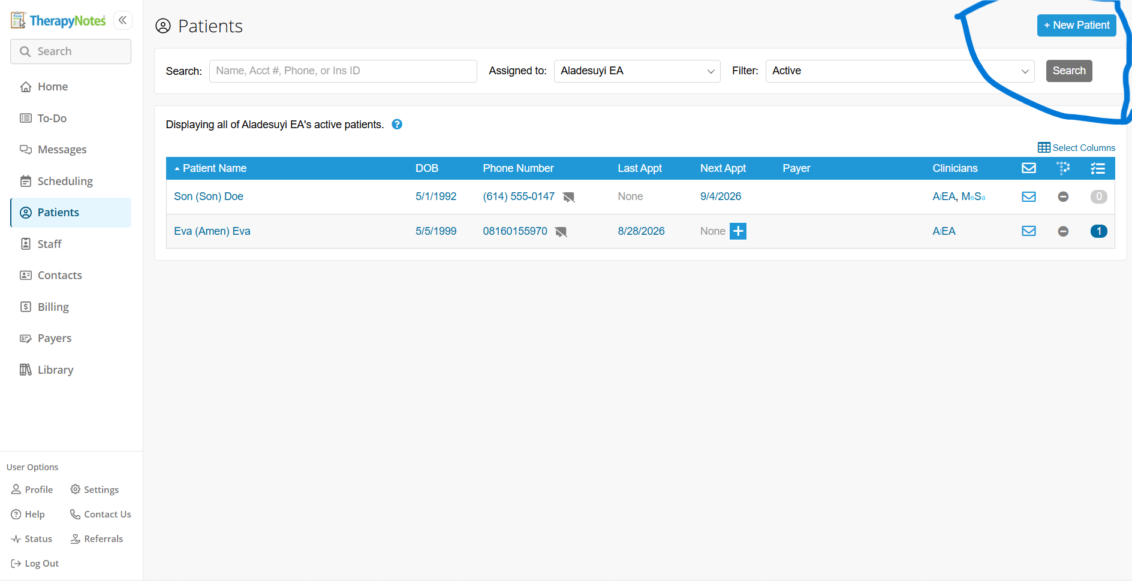

Blossom WOMEN'S HEALTH & WELLNESS CLINIC
PATIENT ONBOARDING & SCHEDULING WORKFLOW
1
Requesting the Appointment
The patient called the clinic to schedule an appointment
STEP 1A
INSERT SCREENSHOT HERE
INSERT SCREENSHOT HERE
e.g., call received / request logged
e.g., patient intent noted
Blossom Women's Health & Wellness Clinic • Patient Onboarding & Scheduling Workflow • OBS & GYN / Women's Health Care

Slide 5
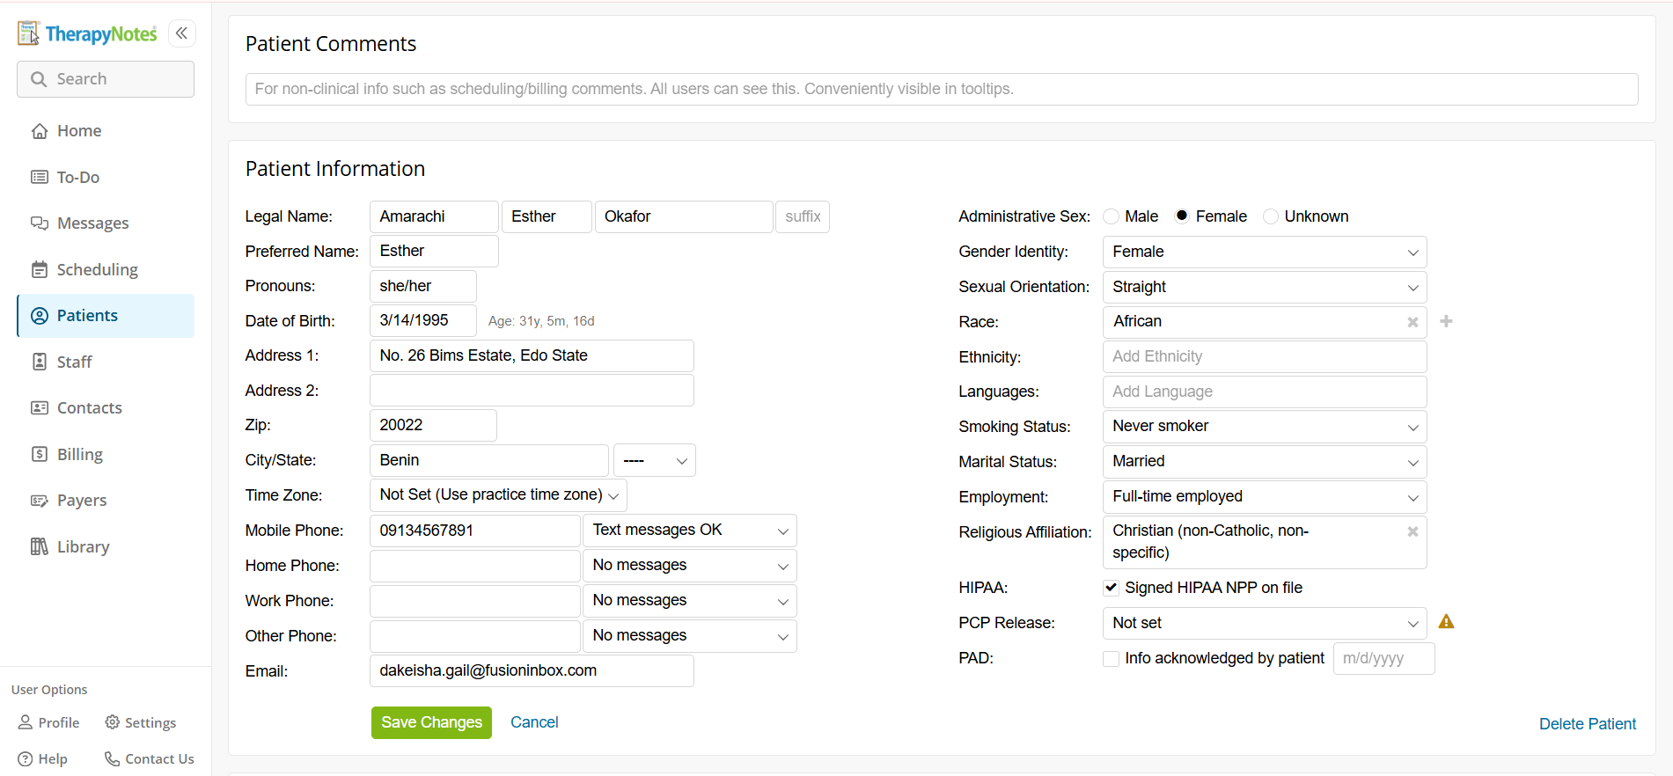
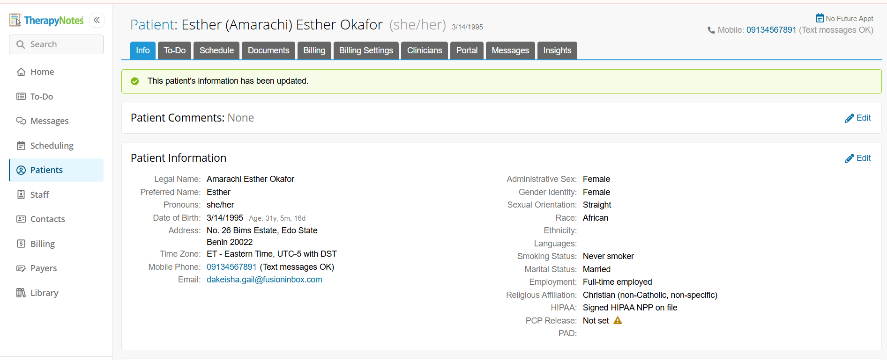
Blossom WOMEN'S HEALTH & WELLNESS CLINIC
PATIENT ONBOARDING & SCHEDULING WORKFLOW
2
Patient Profile Creation
Demographics captured and profile created in the patient portal
STEP 2A
STEP 2B
INSERT SCREENSHOT HERE
Patient Info section where we added patient details
Patient details updated successfully and save in the system. Any blank will be automatically updated once patient fills the intake forms.
Blossom Women's Health & Wellness Clinic • Patient Onboarding & Scheduling Workflow • OBS & GYN / Women's Health Care

Slide 6
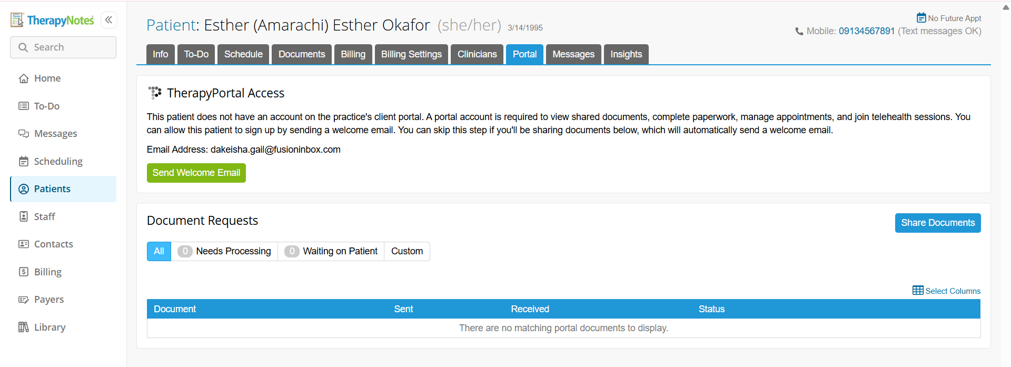
Blossom WOMEN'S HEALTH & WELLNESS CLINIC
PATIENT ONBOARDING & SCHEDULING WORKFLOW
3
Intake Form & Welcome Message Sent
Intake form assigned and welcome message sent to the patient
STEP 3A
INSERT SCREENSHOT HERE
INSERT SCREENSHOT HERE
Welcome email and intake forms interface.
Blossom Women's Health & Wellness Clinic • Patient Onboarding & Scheduling Workflow • OBS & GYN / Women's Health Care

Slide 7
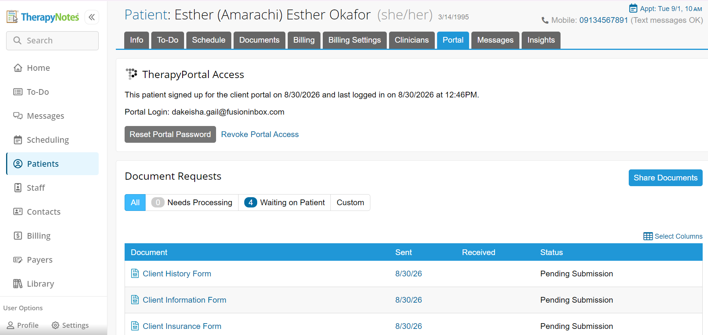
Blossom WOMEN'S HEALTH & WELLNESS CLINIC
PATIENT ONBOARDING & SCHEDULING WORKFLOW
3
Intake Form & Welcome Message Sent (cont'd)
Intake form assigned and welcome message sent to the patient
STEP 3C
STEP 3D
INSERT SCREENSHOT HERE
INSERT SCREENSHOT HERE
Welcome email and patient intake forms sent to Amarachi.
Blossom Women's Health & Wellness Clinic • Patient Onboarding & Scheduling Workflow • OBS & GYN / Women's Health Care

Slide 8
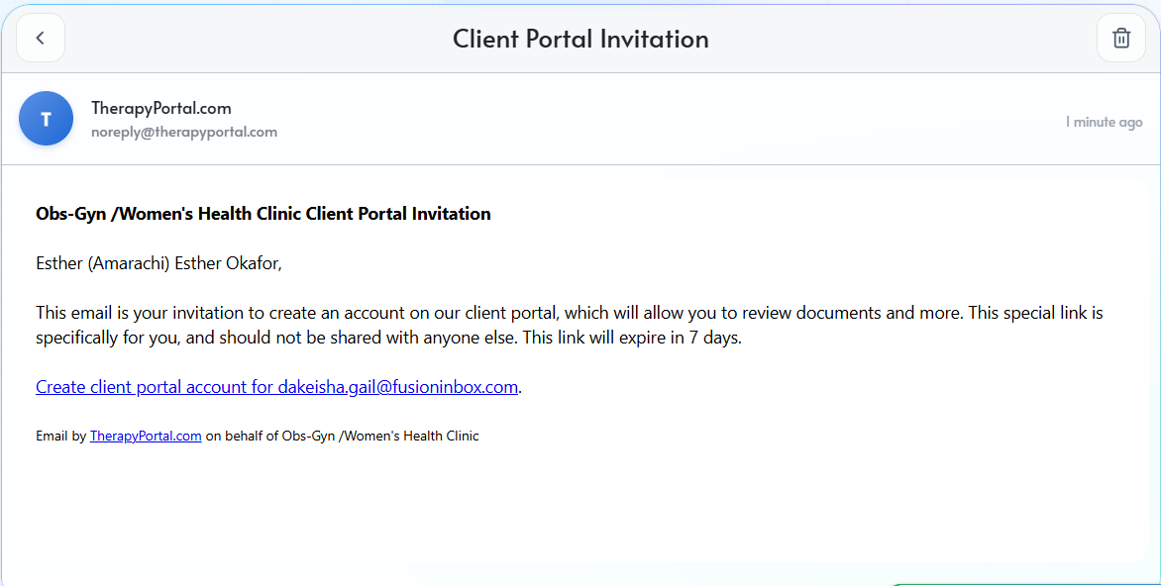
Blossom WOMEN'S HEALTH & WELLNESS CLINIC
PATIENT ONBOARDING & SCHEDULING WORKFLOW
4
Patient Portal Experience
Patient receives the email, sets a password, and logs in
STEP 4A
INSERT SCREENSHOT HERE
INSERT SCREENSHOT HERE
Amarachi’s client portal invitation (Patient View)
Blossom Women's Health & Wellness Clinic • Patient Onboarding & Scheduling Workflow • OBS & GYN / Women's Health Care

Slide 9
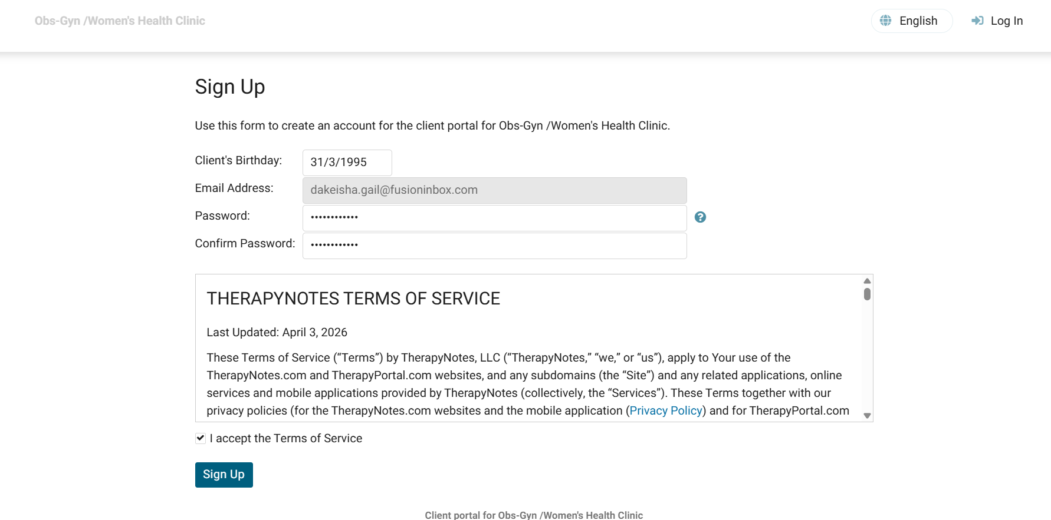
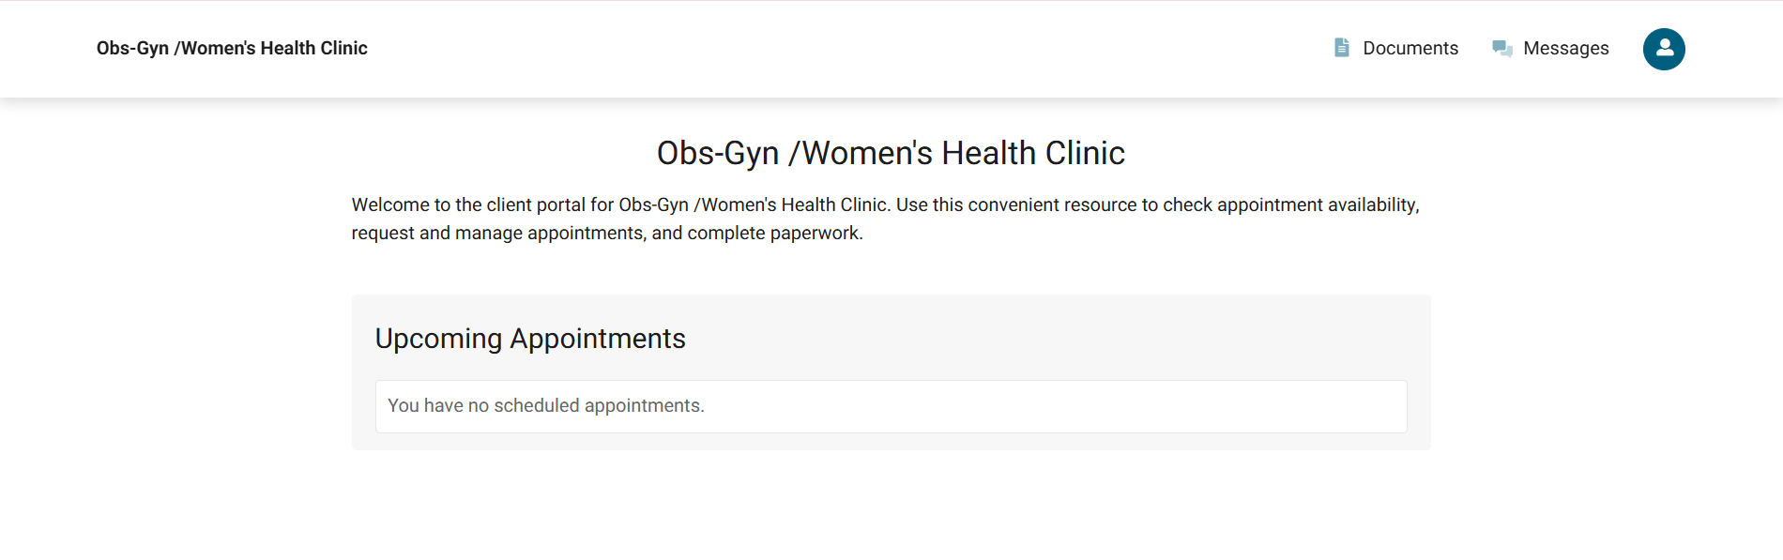
Blossom WOMEN'S HEALTH & WELLNESS CLINIC
PATIENT ONBOARDING & SCHEDULING WORKFLOW
4
Patient Portal Experience (cont'd)
Patient logs in and views the welcome message
STEP 4C
STEP 4D
INSERT SCREENSHOT HERE
Client Portal Login (Amarachi’s view)
Blossom Women's Health & Wellness Clinic • Patient Onboarding & Scheduling Workflow • OBS & GYN / Women's Health Care

Slide 10
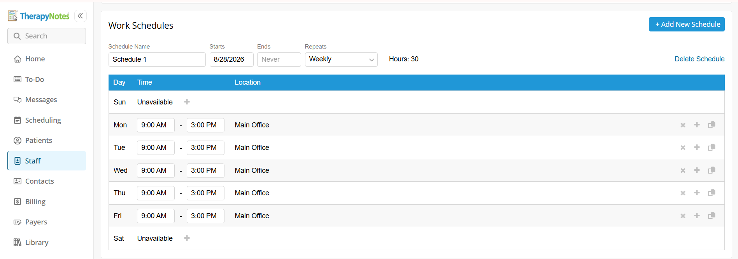
Blossom WOMEN'S HEALTH & WELLNESS CLINIC
PATIENT ONBOARDING & SCHEDULING WORKFLOW
5
Clinician Availability
Clinician availability confirmed
e.g., clinician availability
e.g., 10:00 AM slot selected
Blossom Women's Health & Wellness Clinic • Patient Onboarding & Scheduling Workflow • OBS & GYN / Women's Health Care

Slide 11
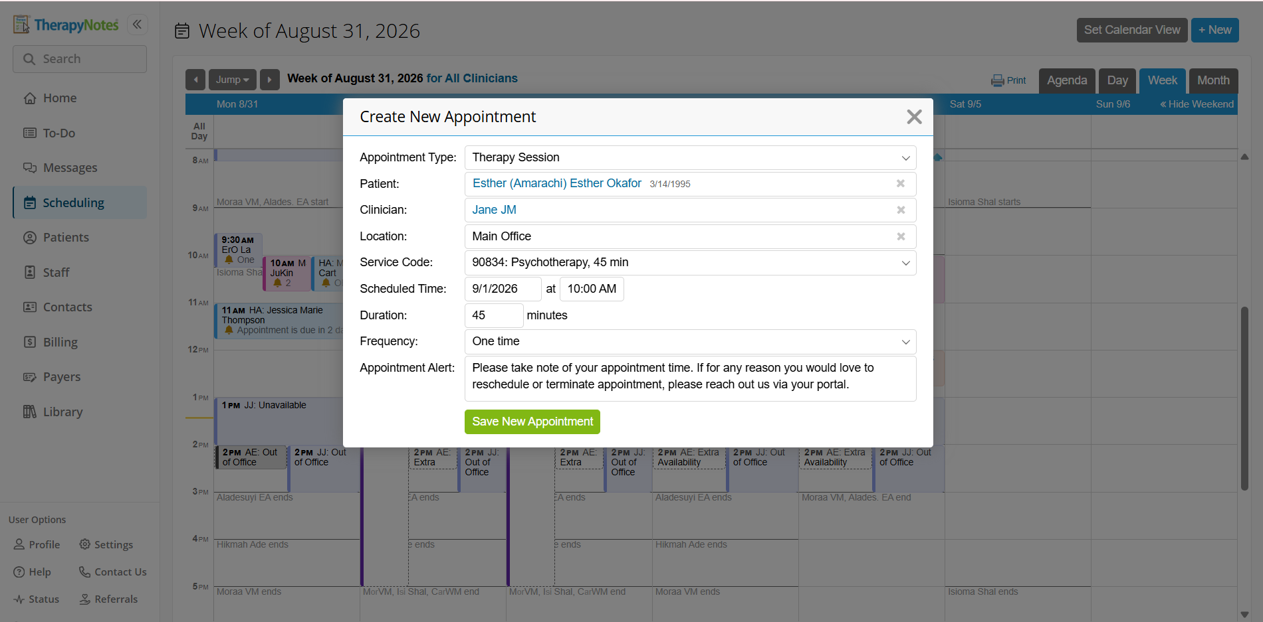
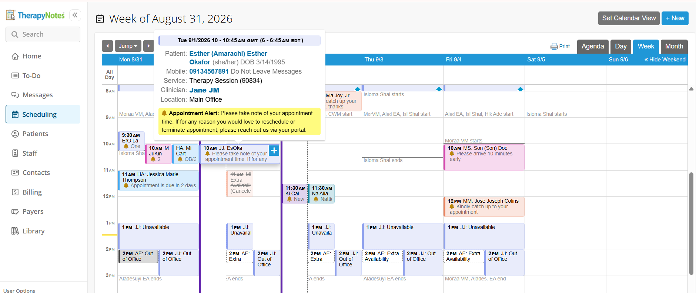
Blossom WOMEN'S HEALTH & WELLNESS CLINIC
PATIENT ONBOARDING & SCHEDULING WORKFLOW
5
Appointment Created and Confirmed
Appointment confirmed and scheduling message sent
INSERT SCREENSHOT HERE
Amarachi’s appointment set up confirmed
Message sent to patient and general calender overview
Blossom Women's Health & Wellness Clinic • Patient Onboarding & Scheduling Workflow • OBS & GYN / Women's Health Care

Slide 12
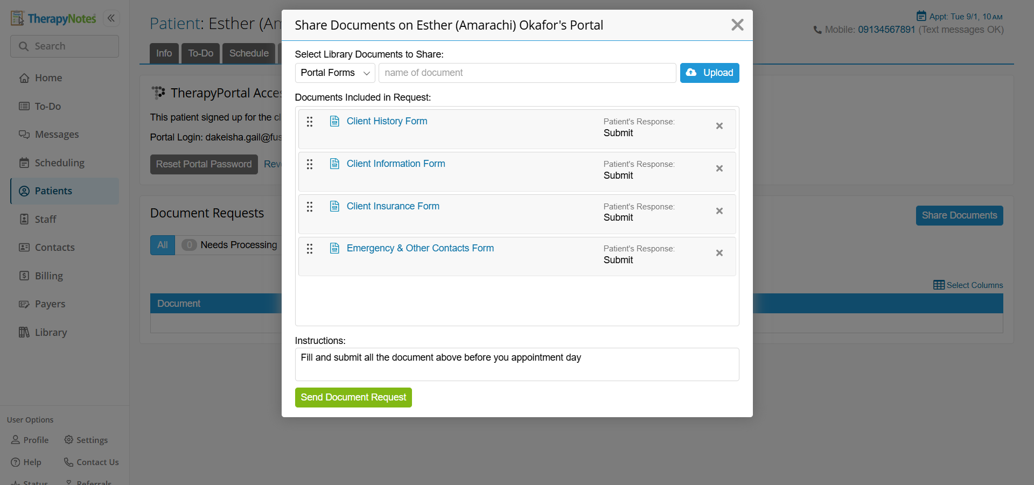
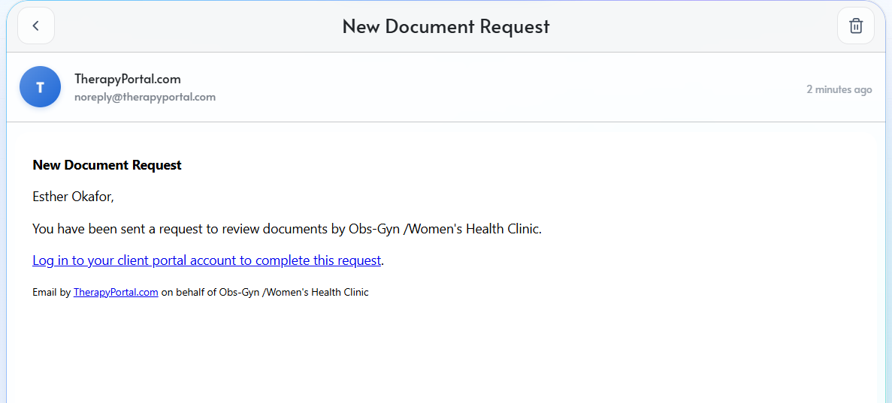
Blossom WOMEN'S HEALTH & WELLNESS CLINIC
PATIENT ONBOARDING & SCHEDULING WORKFLOW
6
Confirmation & Portal Forms Sent
Confirmation sent; intake and consent forms delivered before appointment day
STEP 6A
INSERT SCREENSHOT HERE
Confirmation message sent
Email Received by Amarachi
Blossom Women's Health & Wellness Clinic • Patient Onboarding & Scheduling Workflow • OBS & GYN / Women's Health Care

Slide 13
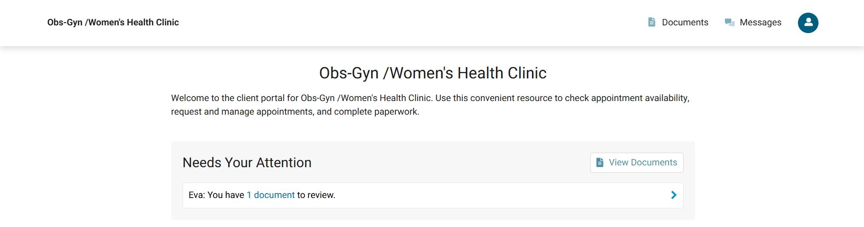
Blossom WOMEN'S HEALTH & WELLNESS CLINIC
PATIENT ONBOARDING & SCHEDULING WORKFLOW
6
Document Sent To Patient's Portal
Intake and consent forms sent before appointment day
INSERT SCREENSHOT HERE
INSERT SCREENSHOT HERE
e.g., intake form sent
e.g., consent form sent
Blossom Women's Health & Wellness Clinic • Patient Onboarding & Scheduling Workflow • OBS & GYN / Women's Health Care

Slide 14
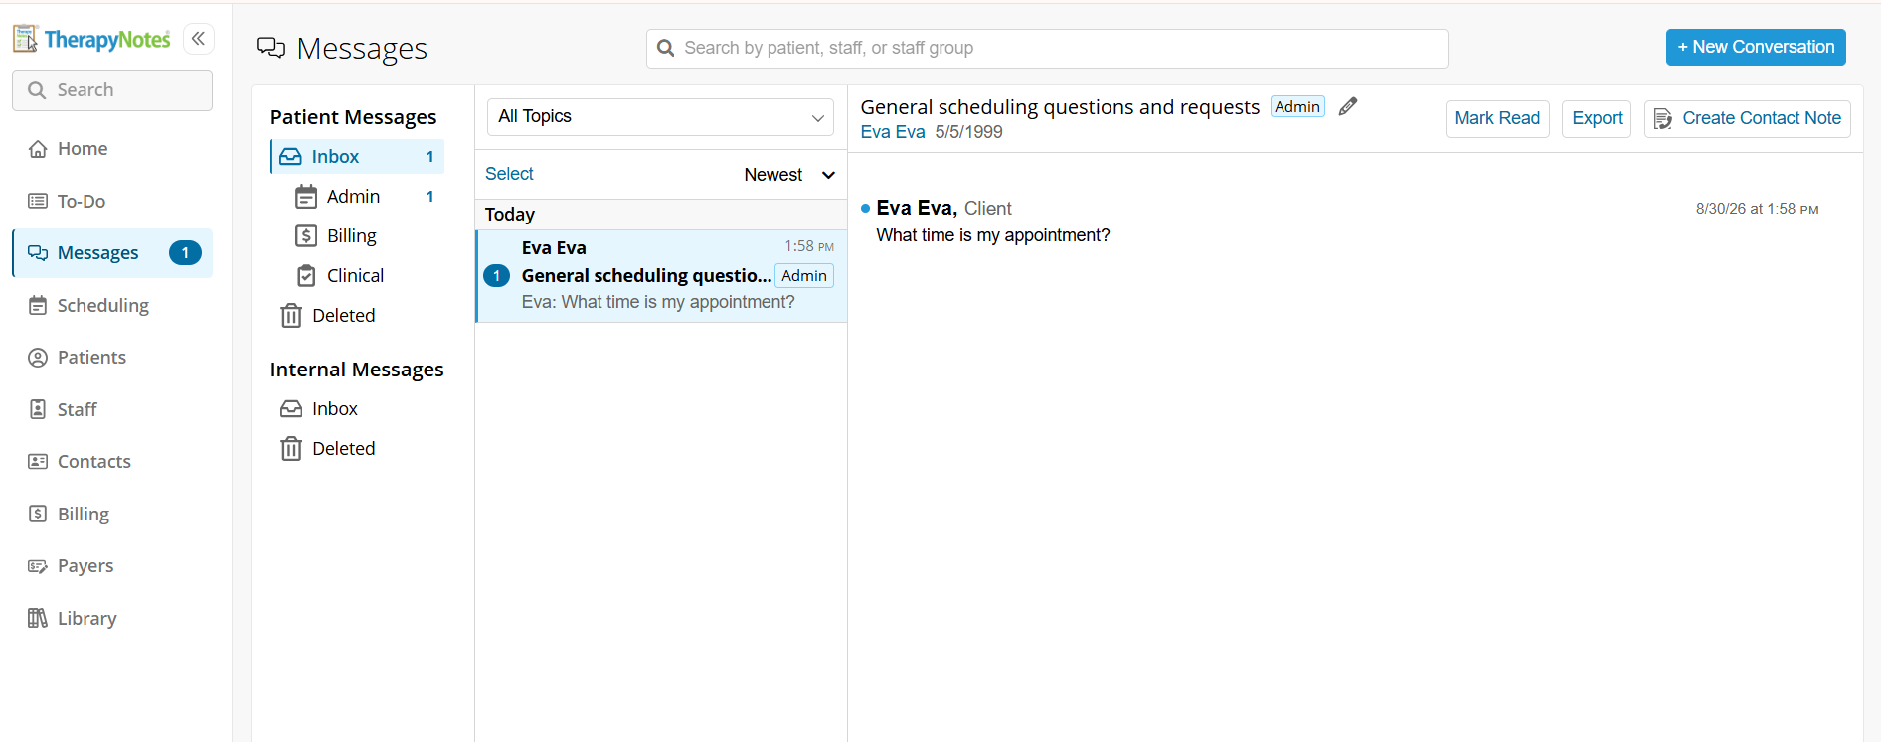
Blossom WOMEN'S HEALTH & WELLNESS CLINIC
PATIENT ONBOARDING & SCHEDULING WORKFLOW
6
Message Sent by the Client
Scheduling Question from Client
STEP 6E
STEP 6F
INSERT SCREENSHOT HERE
INSERT SCREENSHOT HERE
Client Inquiry through the portal.
Blossom Women's Health & Wellness Clinic • Patient Onboarding & Scheduling Workflow • OBS & GYN / Women's Health Care

Slide 15
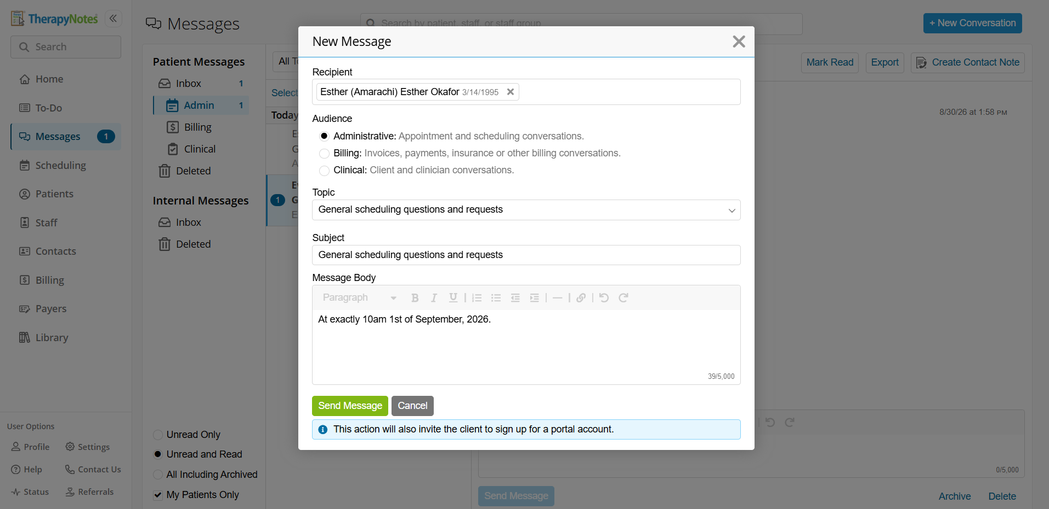
Blossom WOMEN'S HEALTH & WELLNESS CLINIC
PATIENT ONBOARDING & SCHEDULING WORKFLOW
6
New Message Created to Reply Client
Final pre-appointment checklist
STEP 6G
STEP 6H
INSERT SCREENSHOT HERE
INSERT SCREENSHOT HERE
.
Blossom Women's Health & Wellness Clinic • Patient Onboarding & Scheduling Workflow • OBS & GYN / Women's Health Care

Slide 16
Blossom WOMEN'S HEALTH & WELLNESS CLINIC
PATIENT ONBOARDING & SCHEDULING WORKFLOW
Workflow Summary
S
Below is Blossom Health Women’s and Health Clinic intake summary.
1
Patient called to request an appointment
2
Demographics captured; patient profile created
3
Intake form and welcome message sent
4
Patient set up portal access and viewed welcome message
5
Clinician availability checked; appointment booked for 10:00 AM
6
Confirmation sent; intake and consent forms delivered before appointment day
Blossom Women's Health & Wellness Clinic • Patient Onboarding & Scheduling Workflow • OBS & GYN / Women's Health Care

Slide 17
Thank You
Patient Onboarding & Scheduling Workflow — Blossom Women's Health & Wellness Clinic
OBS & GYN / Women's Health Care

